Slide 1



Hardware and Software Fundamentals of Intelligent Computing Systems

Slide 2
Lecture 30: Model Parallelism II (Pipeline Parallelism)

Slide 3
Introduction to PP
PP Optimizations
F-then-B
1F1B
Advanced PP

Slide 4
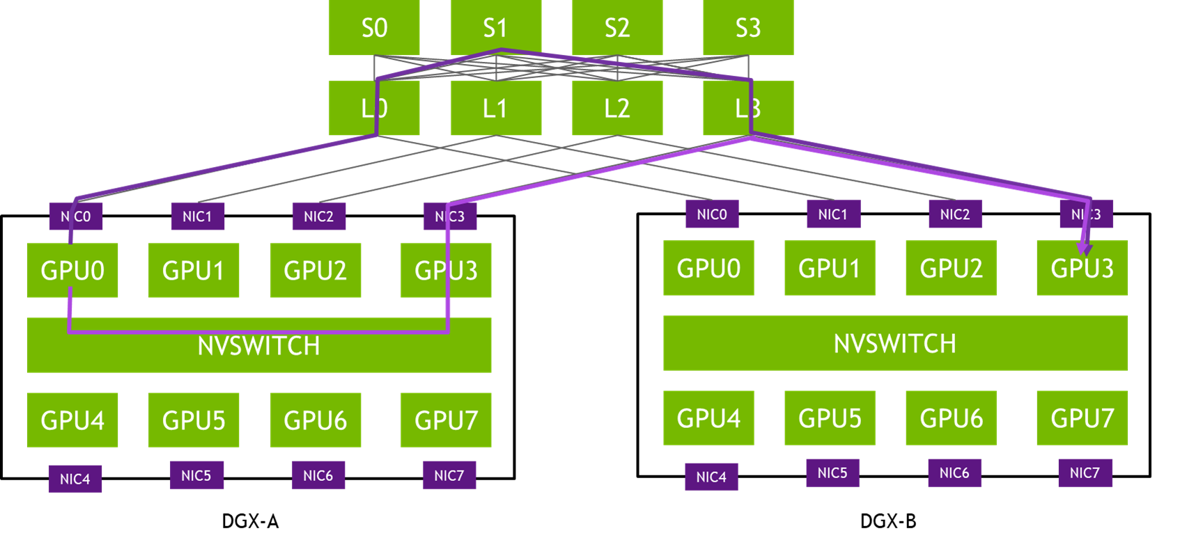
Introduction to Inter-Node Scaling
TP is computationally efficient but mathematically requires synchronous All-Reduce operations, rendering it unsuitable for inter-node scaling.
Ethernet/Infiniband latency would catastrophically bottleneck GPU utilization.
To scale deep LLMs across multiple nodes, the system must slice the model longitudinally.
Pipeline Parallelism (PP) assigns sequential blocks of layers to different physical nodes.

Slide 5
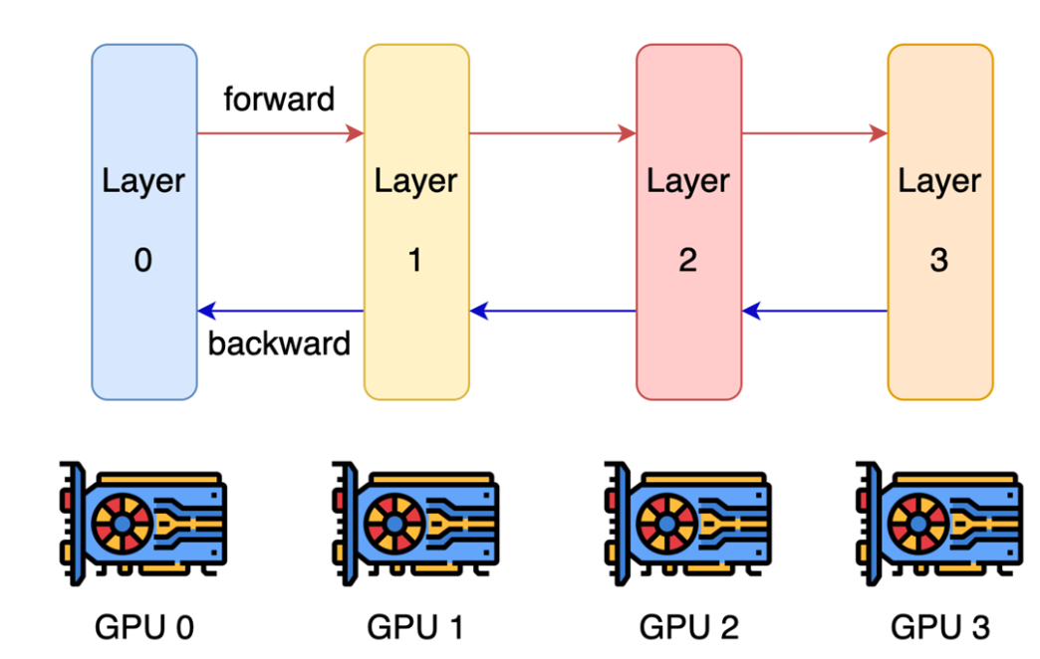
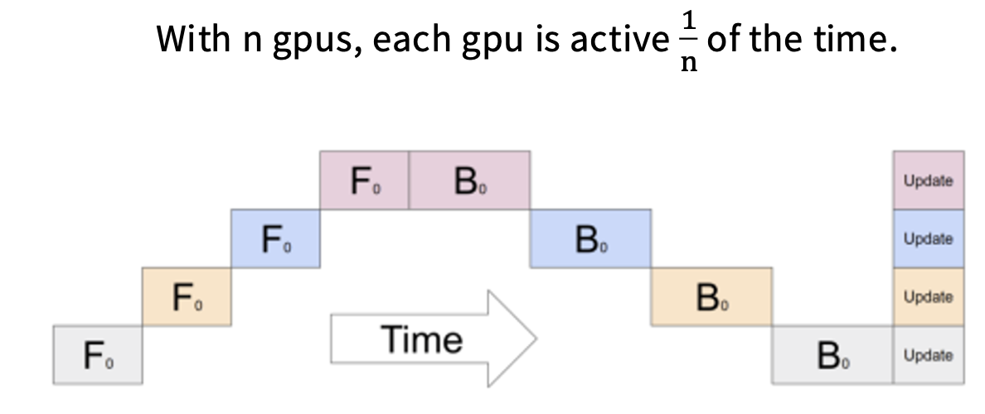
Pipeline Parallelism (PP)
Layer-wise parallel cuts up layers, assigns some subset to GPUs (K stages)
Activations and partial gradients are passed back and forth
Each GPU is idling most of the time, waiting for the backward pass to propagate back

Slide 6
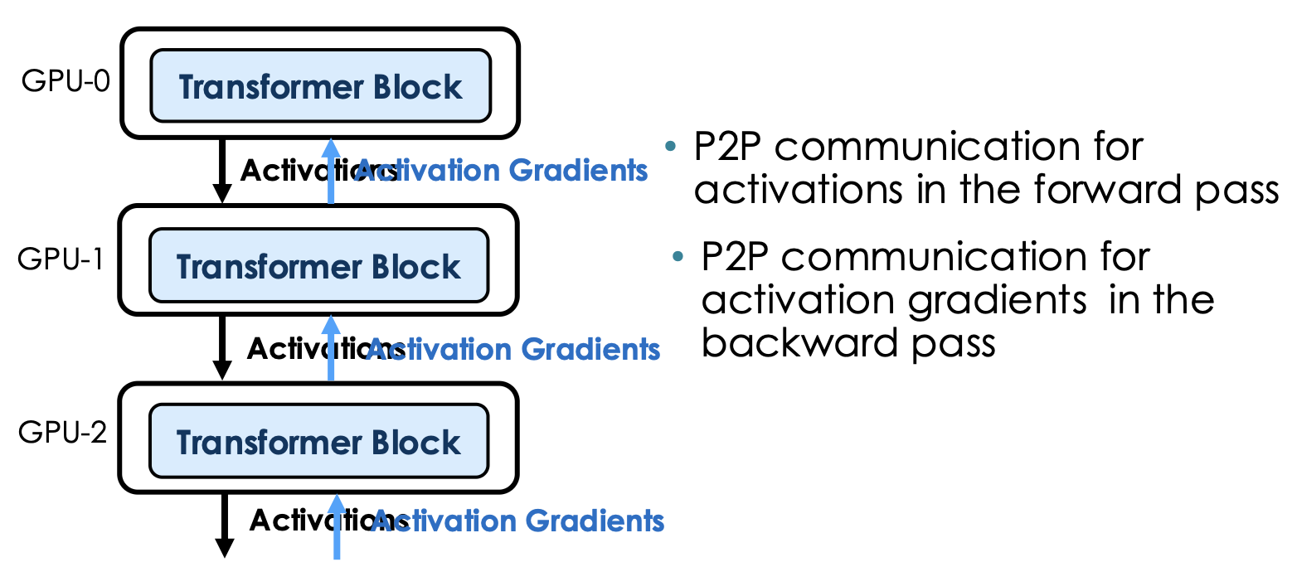
Pipeline Parallelism
Communication pattern

Slide 7
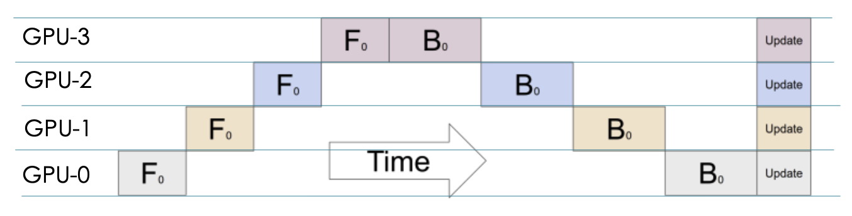
Pipeline Parallel: Forward-then-Backward
Execution timeline
How to make GPUs busy?
Batch split!

Slide 8
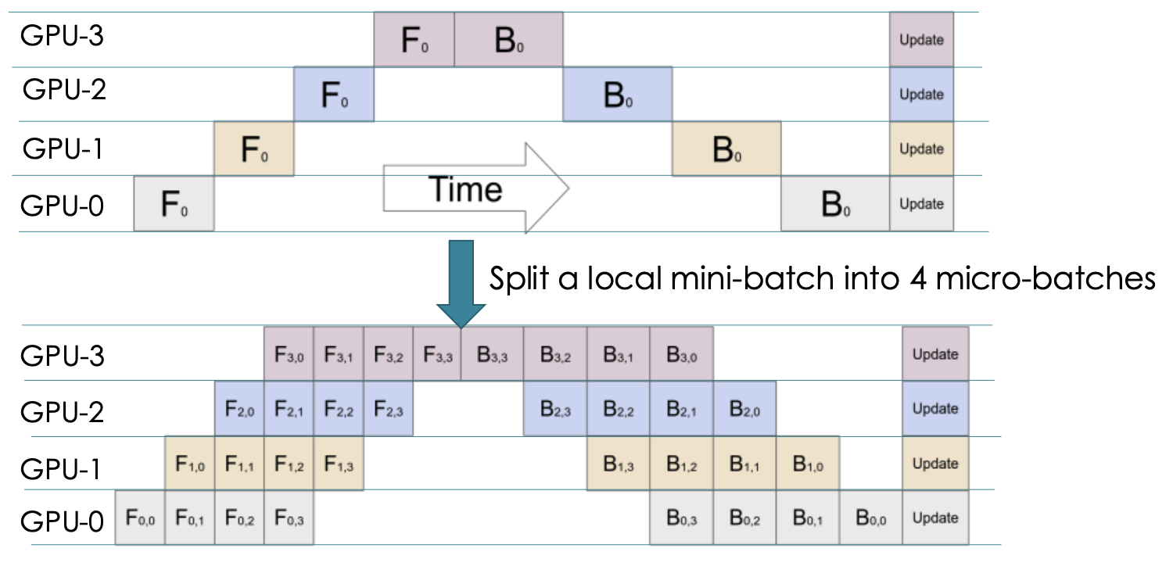
Pipeline Parallel: Forward-then-Backward
GPipe (Google, 2019)
Divide the global mini-batch into M smaller "micro-batches"
To maximize TFLOPS, increase Global Batch Size to fit more micro-batches into the pipe.

Slide 9
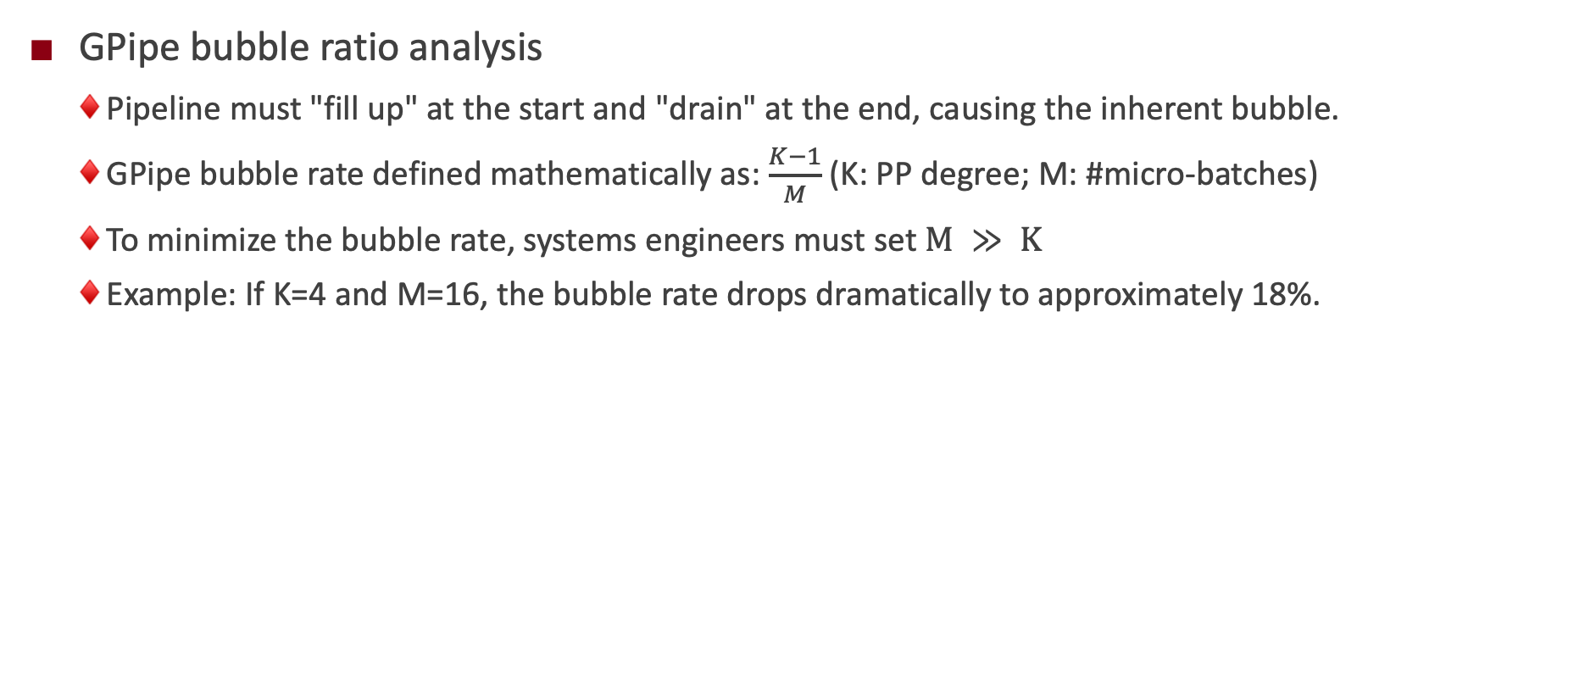
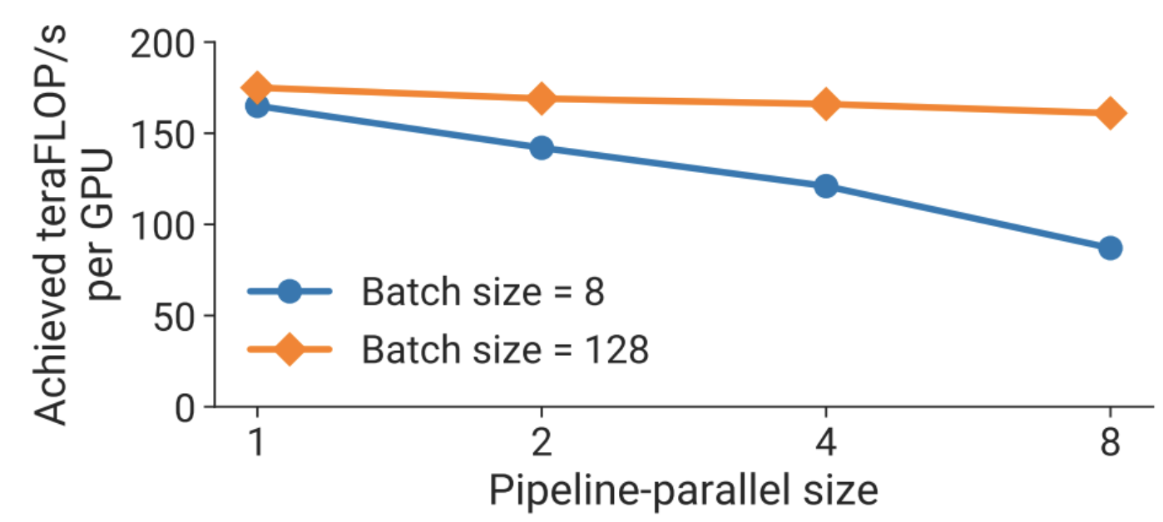
Pipeline Parallel: Forward-then-Backward

Slide 10
Why pipeline parallel?
1. Pipelines save memory (compared to DDP)
2. Pipelines can have good communication properties (compared to FDSP and TP)
It depends only on activations and is point to point
Generally, we will use pipelines on slower network links (i.e. inter-node) as a way to get better memory-wise scaling.

Slide 11
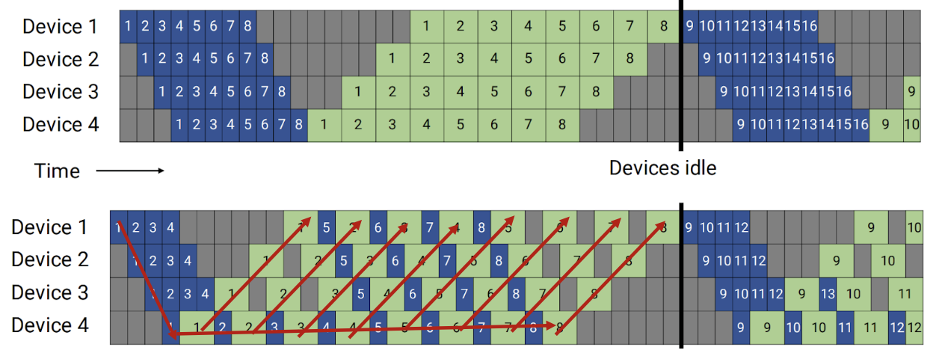
Pipeline Schedule Optimization
PipeDream proposes a “1F1B” schedule
Once the warm-up phase concludes, GPUs alternate: compute one forward pass, immediately compute one backward pass.
Prioritizes backward passes to change the lifecycle of cached data.
Peak on-the-fly
Micro-batches
GPipe
(F-then-B)
O(M)
PipeDream
(1F1B)
O(K)

Slide 12
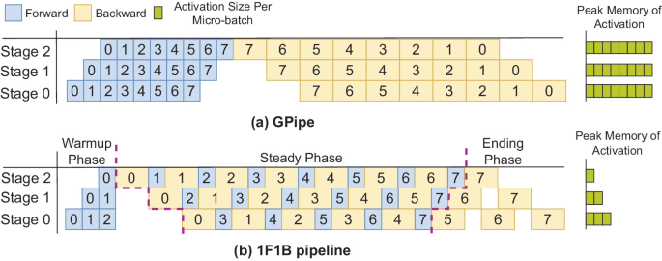
Pipeline Schedule Optimization
GPipe memory crisis
GPipe is strictly synchronous: all M forward passes must complete before any backward pass begins.
Backward passes absolutely require intermediate activations.
Every pipeline stage must cache activations for all M micro-batches simultaneously.
As M scales to shrink the bubble, activation memory scales linearly O(M), rapidly triggering OOM

Slide 13
Pipeline Schedule Optimization
1F1B memory footprint
1F1B executes backward passes as early as mathematically possible.
Heavily cached activations are consumed for gradients and instantly discarded.
Max in-flight activations any GPU must store is strictly bounded by pipeline depth K, rather than M.
Decouples peak activation memory from micro-batch count, allowing infinite M scaling (memory permitting).

Slide 14
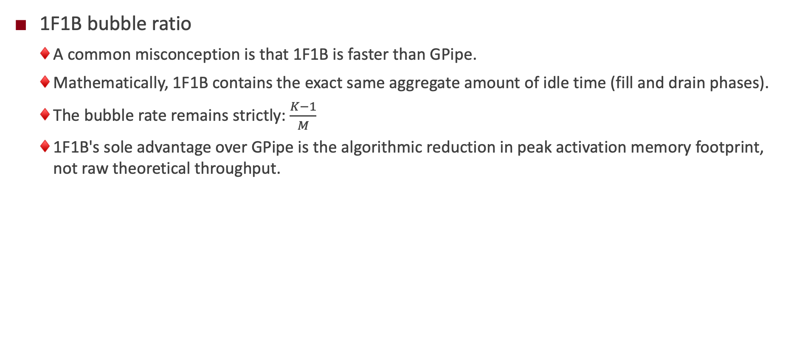
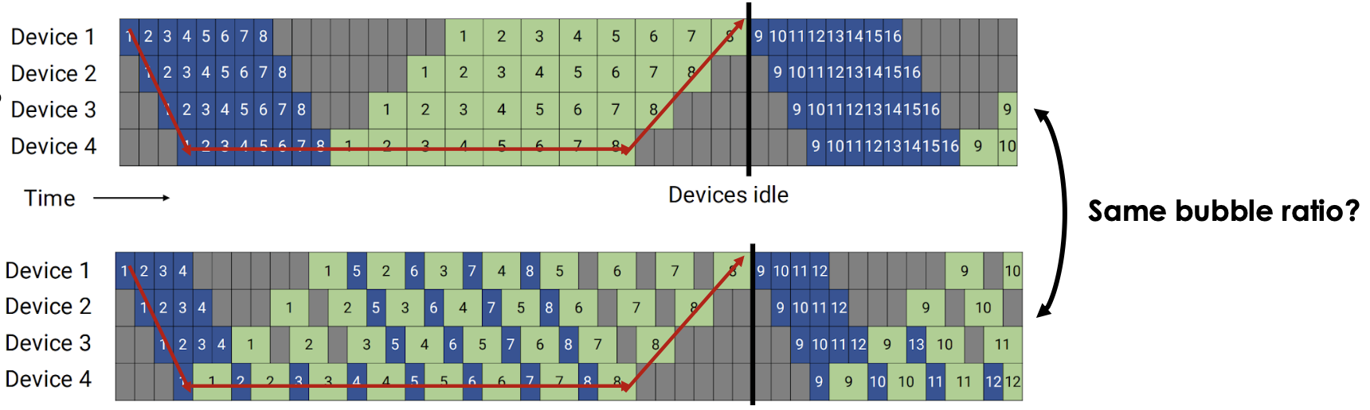
Pipeline Schedule Optimization
Notes:
单击此处添加文本

Slide 15
Limitations of 1F1B and Larger Batch Sizes
To achieve negligible bubble rates (<5%), M must be exceedingly high.
Global batch size is mathematically constrained by optimizer convergence limits.
If global batch size is fixed, scaling M shrinks individual micro-batch sizes toward 1.
Small micro-batches underutilize modern GPU Tensor Cores, destroying arithmetic intensity.
A novel schedule is required to reduce bubbles without increasing M.

Slide 16
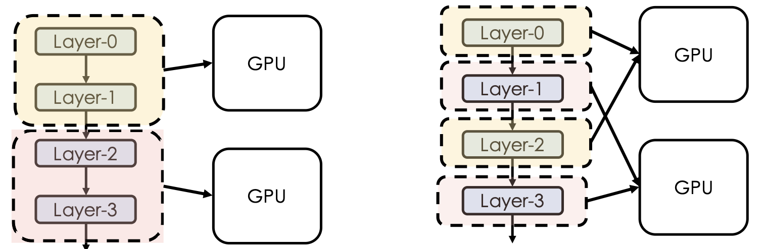
Interleaved 1F1B (Megatron-LM)
One micro batch will go through both GPU but now twice.
GPU are now busy working, just like we have two batches
One micro-batch will go through both GPU but only once

Slide 17
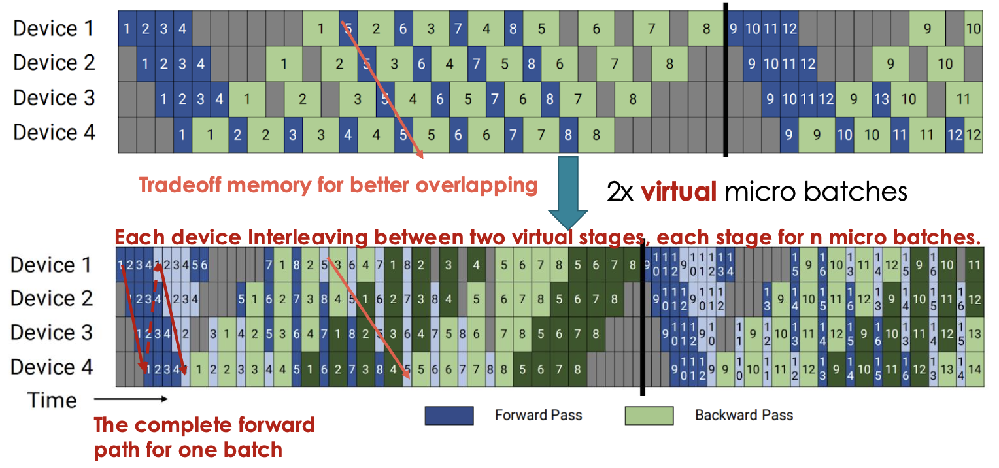
Interleaved 1F1B (Megatron-LM)
Divides the model into a larger number of "virtual stages" (V stages per GPU).
GPU 1 is assigned Virtual Stage 1 (e.g., layers 1-2) and Virtual Stage 5 (e.g., layers 9-10) simultaneously

Slide 18
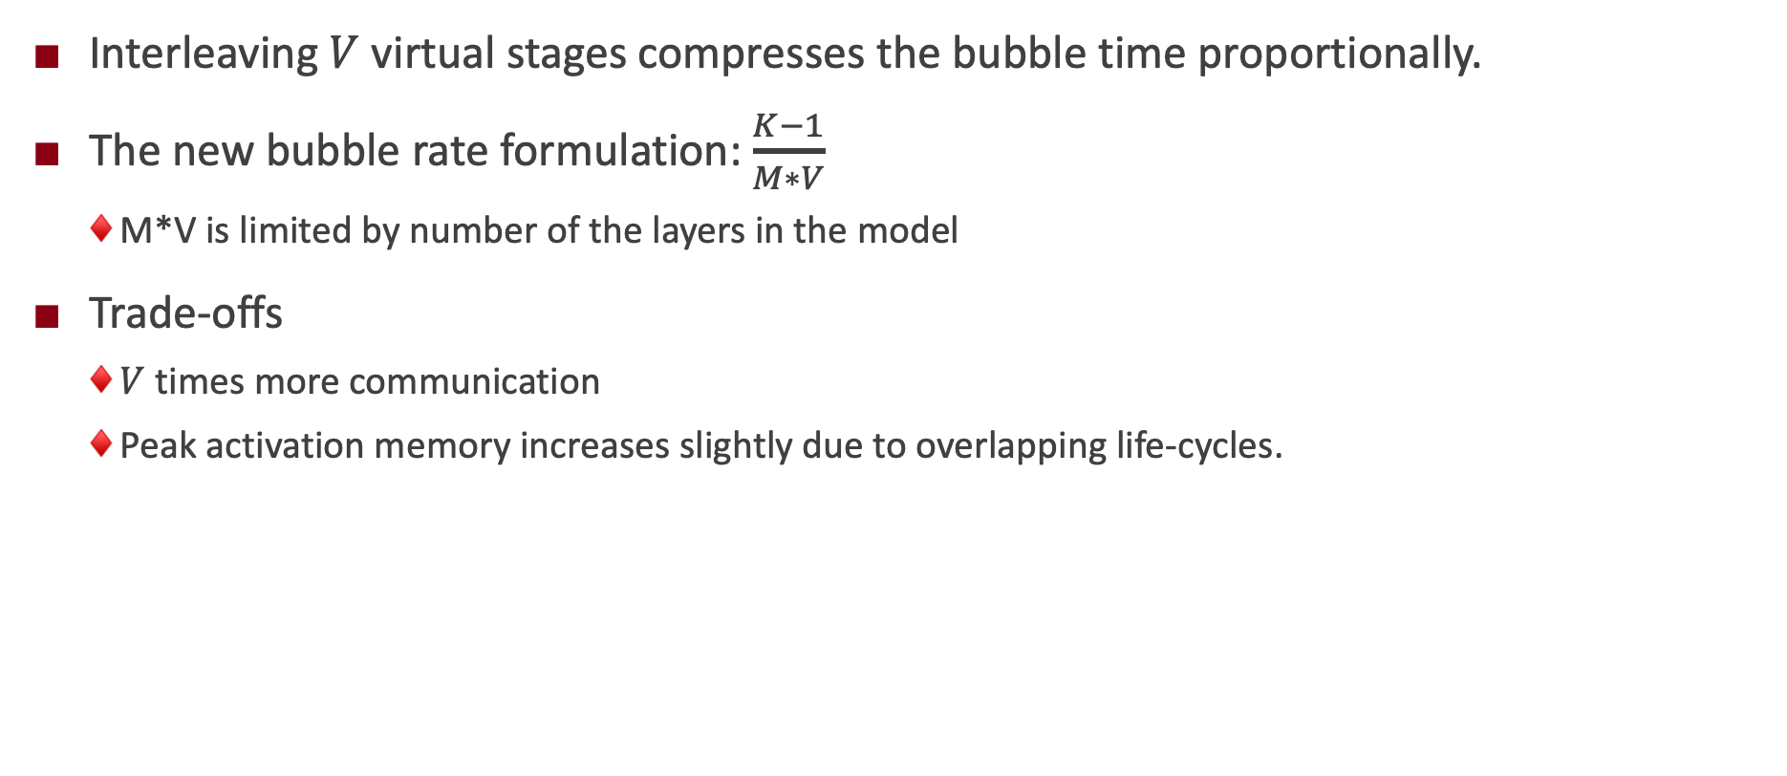
Interleaved 1F1B (Megatron-LM)

Slide 19
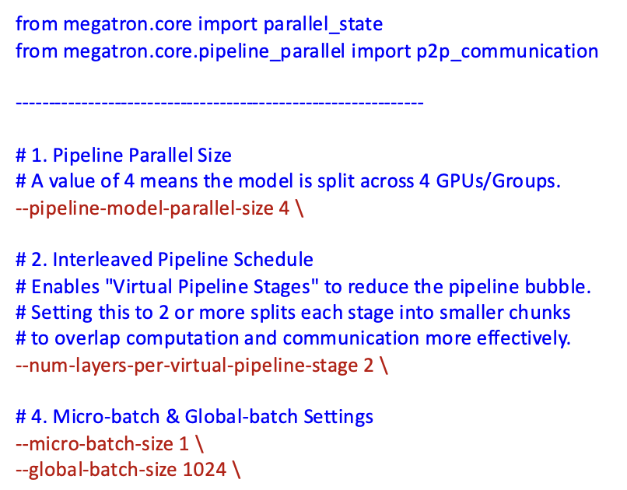
Interleaved 1F1B (Megatron-LM)
Megatron-core recommends Interleaved 1F1B by default
#layers in virtual pipeline state typically set to 2-4.

Slide 20
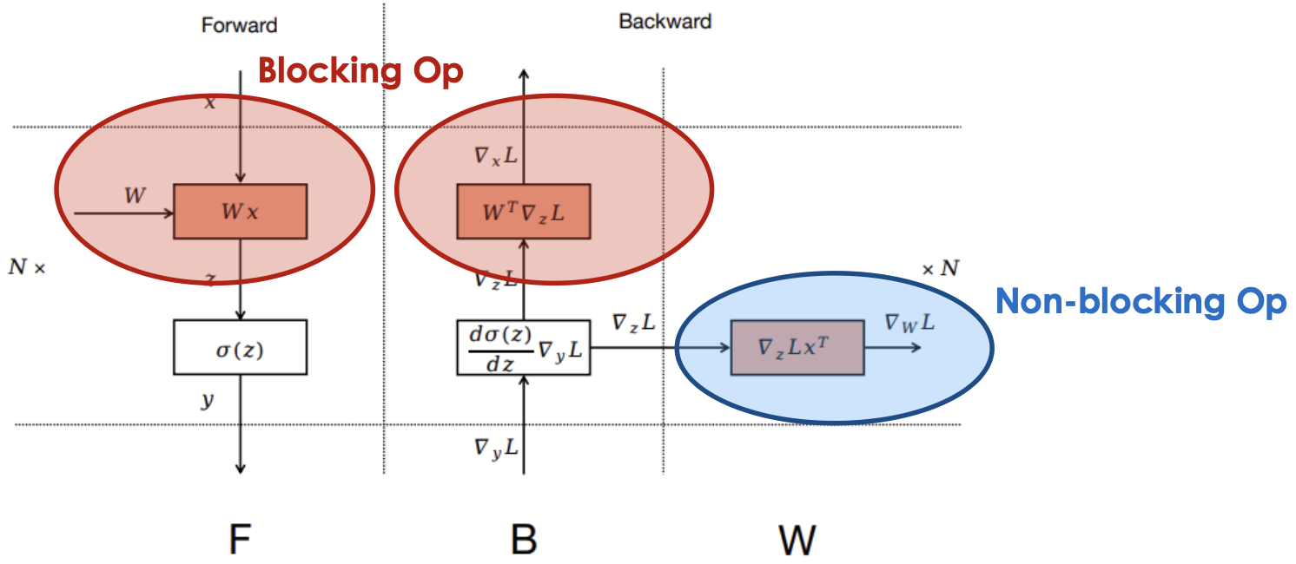
Advanced PP: Zero-bubble Pipeline (ICLR’24)
Key insight:
Separate blocking and non-blocking computation to enable more flexible pipeline schedule.

Slide 21
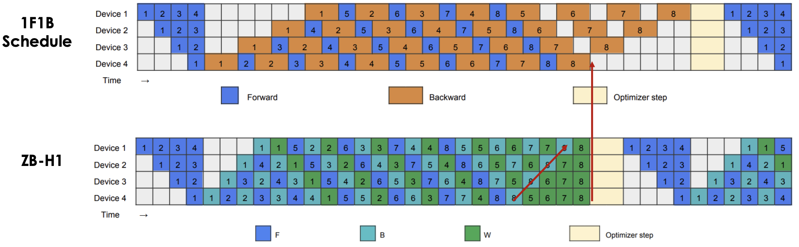
Advanced PP: Zero-bubble Pipeline (ICLR’24)
Small scale: Integer Linear Programming, for both memory and end-to-end makespan optimization
Large scale: heuristics
Less #PP communications than interleaved 1F1B, but similar/less bubbles.

Slide 22
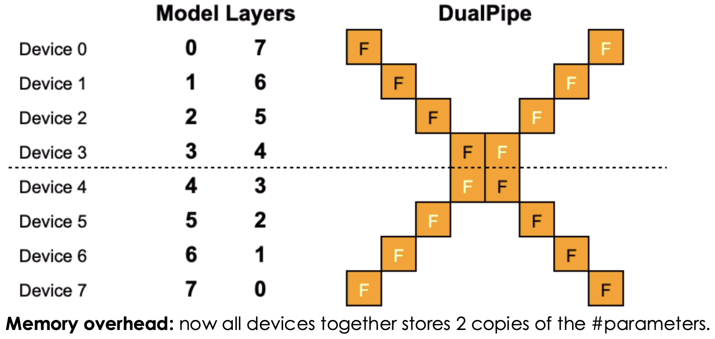
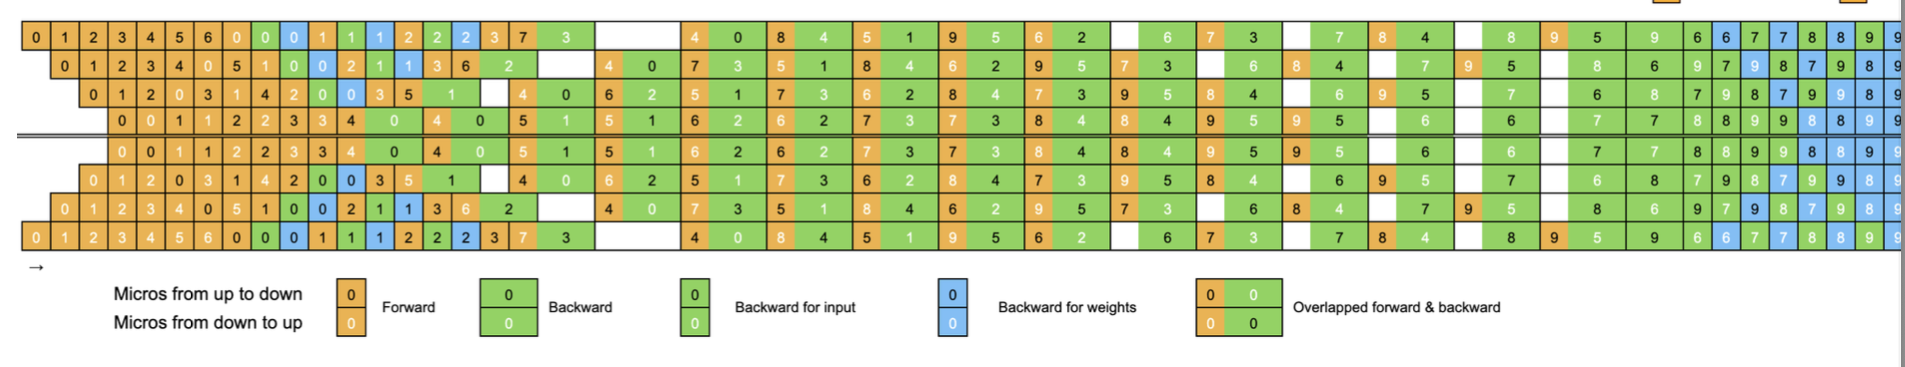
Advanced PP: DeepSeek-V3 DualPipe (2025)
Sharding strategy
DeepSeek V3: https://arxiv.org/pdf/2412.19437v1, 2025

Slide 23
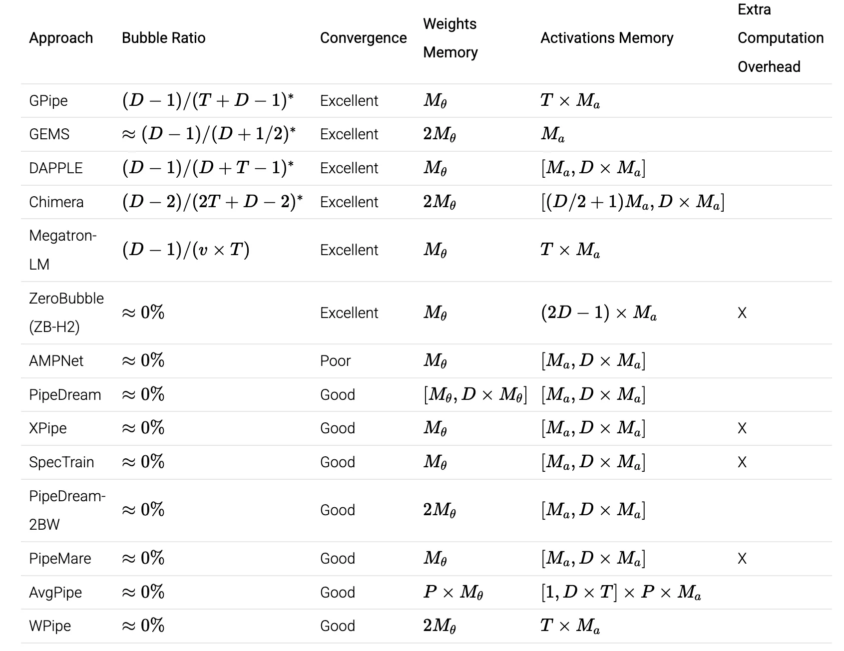
Advanced PP
https://selamjie.medium.com/the-frontier-of-pipeline-parallelism-an-overview-d4264cc9f877

Slide 24

The Solution: FlagOS, a Unified AI Software Stack

Slide 25








https://space.bilibili.com/3546791834290849
https://github.com/flagos-ai
https://www.zhihu.com/people/95-22-20-18/posts
https://flagos.io/Home

Slide 26

Thanks for your time！

